Slide 1
Loyola University Chicago
FACHEX and Tuition Exchange

Slide 2
FACHEX
Established by Association of Jesuit Colleges and Universities (AJCU) in 1971
FACHEX is an acronym for Faculty and Staff Children Exchange.
Twenty-six Jesuit universities participate in the FACHEX program (Georgetown University is the only AJCU school not participating).

Slide 3
Tuition exchange program (TEP)
Starting Fall 2023
TEP is a reciprocal scholarship opportunity for the dependents of eligible faculty and staff at all Tuition Exchange member schools.
Membership currently includes more than 670 institutions, ranging in size from 250 to 50,000 students and representing 47 U.S. states, the District of Columbia, and several other countries.

Slide 4
Eligibility for Loyola faculty and staff dependents
All LUC employees must have completed at least one year of continuous full-time employment to be considered eligible to apply for FACHEX/TEP at other participating institutions.

Slide 5
Application process overview
The following slides will help guide your student through the account creation and application process.
The account and application are for BOTH FACHEX and TE. The student does not need to create one for each program.
The TE EZ-Application is for scholarship consideration at outside institutions.
The deadline to submit the TEP EZ-Application is December 1, 2026
If your student is interested in attending Loyola Chicago and you are interested in utilizing our internal tuition benefit program, this is NOT that process. Please visit our HR website for steps needed to receive the tuition benefit at Loyola University Chicago: Tuition Benefit | Human Resources: Loyola University Chicago

Slide 6
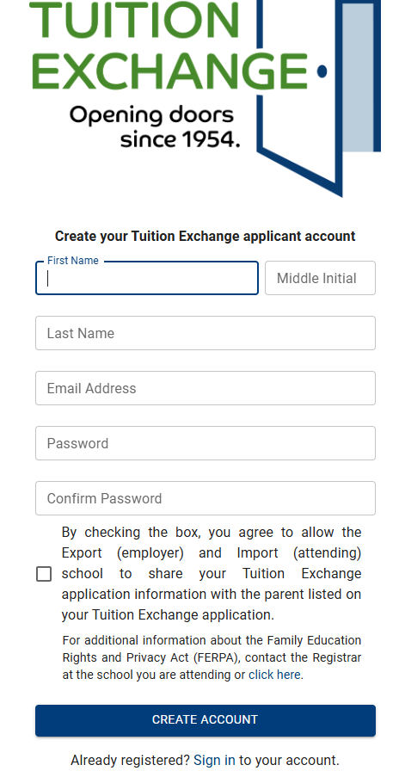
Application process: Step 1
Create a TE account at Tuition Exchange
The TE Account is all about the student. Do NOT create an account as the employee
The student should have an email account besides their high school email address

Slide 7

Application process: Step 2
Have the student log in to their account to complete the EZ-Application: Tuition Exchange

Slide 8
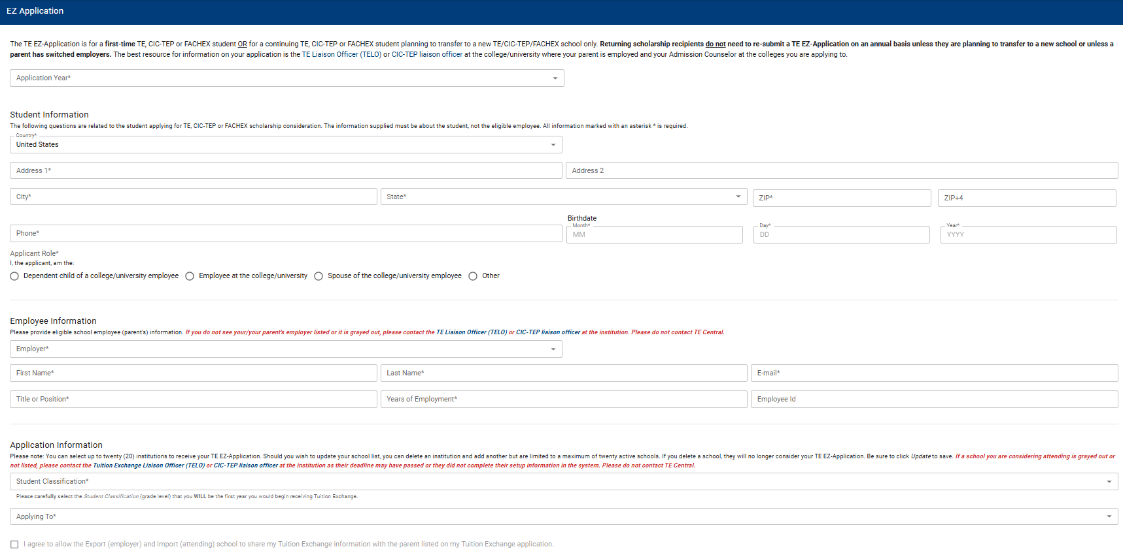
EZ-application
Select the 2027-2028 Academic Year
The Student must complete each field
The Student much select ‘Dependent of a college/university employee’
Complete all fields with the employee’s information
Select the institutions the student is interested in applying for FACHEX/TE

Slide 9
What Happens when the student submits their te EZ-application?
Once the TE EZ-Application is completed and submitted, it will be sent to Loyola Chicago’s TE liaison for review and approval.
Once EZ-Application is approved an email will automatically be generated to the selected schools.
There are no additional steps you need to take with Loyola Chicago once the EZ-Application is submitted.

Slide 10
Selection and availability of awards
These are highly competitive awards.
The home institution determines eligibility requirements and determines the number of FACHEX/TEP awards it will grant to incoming students each year.
There are no guarantees that your dependent will be selected to receive FACHEX or TEP.
Award determinations are made at various times, but no later than April 1.
The student and employee are notified via email and/or letter from the host school.
Some institutions only accept first semester freshman students, while others may make awards to transfer or current students.

Slide 11
Other important information
Some institutions require the completion of the FAFSA each year
You are NOT required to accept or decline an offered FACHEX or TEP award until the May 1 deposit deadline.
Your eligibility to receive the FACHEX/TEP benefit will reviewed in the Spring of each year. If you remain eligible, Loyola will submit a recertification to the host school. You do not need to submit a new application.

Slide 12
Loyola Tuition Benefit
There is no application form if your dependent is interested in attending Loyola Chicago.
The student must be listed as a dependent or LDA of the Faculty or Staff member in Lawson’s Employee Self Service benefits portal.
Visit the HR website for more information: Tuition Benefit | Human Resources: Loyola University Chicago

Slide 13
Commonly Asked questions

Slide 14
Does my student need to apply and/or be accepted before they can complete the TE EZ-application?
No! You will want your student to complete the TE EZ-Application as quickly as possible.
They do not need to wait to apply for admissions or be accepted to complete the EZ-Application.
Even if they are unsure of where they may apply, they can still send the TE EZ-Application to a school they are considering. It does not hurt their application in anyway!

Slide 15
What criteria does an institution consider when awarding FACHEX/TEP?
Each institution establishes its own awarding criteria, but common practice includes a review of the student’s high school GPA, test scores, class rank, number of AP or honors courses, and dual-credit.

Slide 16
Are these awards competitive?
Yes, very competitive. To put the application process in perspective, Loyola Chicago receives approximately 600 FACHEX/TEP applications each year and we award between 20-25 scholarships annually.

Slide 17
Do I need to complete the FAFSA?
It depends! Review the FACHEX/TEP requirements posted on the host schools website to see what additional requirements are needed in order to be considered for FACHEX/TEP.

Slide 18
Is there a limit on how many institutions I can select?
TEP is restricted to twenty (20) selections.

Slide 19
How much does the FACHEX or TEP award cover?
It depends. In addition to determining eligibility, each school decides how much FACHEX or TEP will cover in terms of tuition and/or room and board.

Slide 20
What happens if I do not receive a FACHEX/TEP award offer?
If you are notified that your student was not selected for FACHEX/TEP, you should reach out to the FACHEX/TEP liaison and ask if there is a waitlist. Some schools do this automatically, as long as you remain active and do not withdraw your admissions application. Others may wait for you to reach out and ask to be put on the waitlist.

Slide 21
reminders and recommendations
Submit your application(s) by December 1.
Reach out to the FACHEX/TEP liaison at the schools you are interested in applying for specific information regarding their process
Please review the FACHEX/TEP website for additional information and policy updates: FACHEX and Tuition Exchange | Financial Aid Office: Loyola University Chicago

Slide 22
Who is Loyola’s FACHEX/TEP Liaison?
LUC's FACHEX and Tuition Exchange liaison officer is Tobyn Friar, Assistant Vice President.
All questions about these programs can be directed to his attention by emailing at tfriar@luc.edu.

